Slide 1



CONSUMER GOODS AD-HOC INSIGHTS Prepared By :ABHIJITH M
SQL CHALLENGE

Slide 2
PROBLEM STATEMENT
Atliq Hardwares (imaginary company) is one of the leading computer hardware producers in India and well expanded in other countries too.
However, the management noticed that they do not get enough insights to make quick and smart data-informed decisions. They want to expand their data analytics team by adding several junior data analysts. Tony Sharma, their data analytics director wanted to hire someone who is good at both tech and soft skills. Hence, he decided to conduct a SQL challenge which will help him understand both the skills.

Slide 3
TASK TO PERFORM
1. Check ‘ad-hoc-requests.pdf’ - there are 10 ad hoc requests for which the business needs insights. 2. need to run a SQL query to answer these requests. 3. The target audience of this dashboard is top-level management - hence need to create a presentation to show the insights

Slide 4

REQUEST 1:
1.Provide the list of markets in which customer "Atliq Exclusive" operates its business in the APAC region.
QURIED RESULT

Slide 5
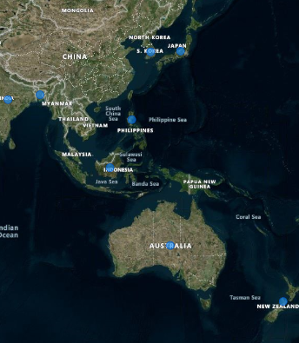
INSIGHTS:
Emerging Markets: India, Indonesia, Bangladesh, and the Philippines, where rapid economic growth presents opportunities for market expansion.

Slide 6

REQUEST 2:
What is the percentage of unique product increase in 2021 vs. 2020? The final output contains these fields :
unique_products_2020
unique_products_2021
percentage_chg
QURIED RESULT

Slide 7
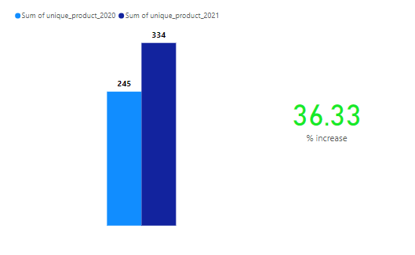
INSIGHTS:
Between 2020 and 2021, Atliq Hardwares experienced a 36.33% increase in the number of unique products, growing from 245 products in 2020 to 334 in 2021.

Slide 8
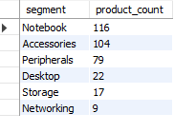
REQUEST 3:
Provide a report with all the unique product counts for each segment and
sort them in descending order of product counts. The final output contains
2 fields:
segment
product_count
QURIED RESULT

Slide 9
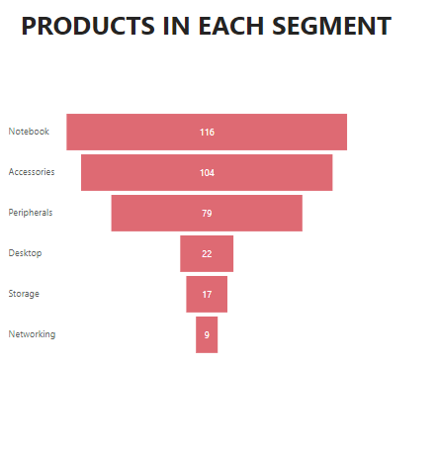
INSIGHTS:
The product portfolio for Atliq Hardwares is dominated by the Notebook segment (116 products) and Accessories (104 products), together accounting for a significant portion of the total products.. Key Takeaway: The emphasis on Notebooks and Accessories indicates a customer-centric approach targeting mobility and personalization. However, expanding offerings in Networking and Storage could unlock new opportunities in enterprise and data-driven markets.

Slide 10
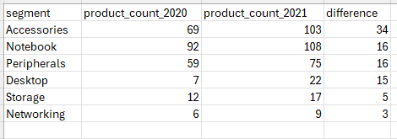
REQUEST 4:
Follow-up: Which segment had the most increase in unique products in
2021 vs 2020? The final output contains these fields,
segment
product_count_2020
product_count_2021
difference
QURIED RESULT

Slide 11
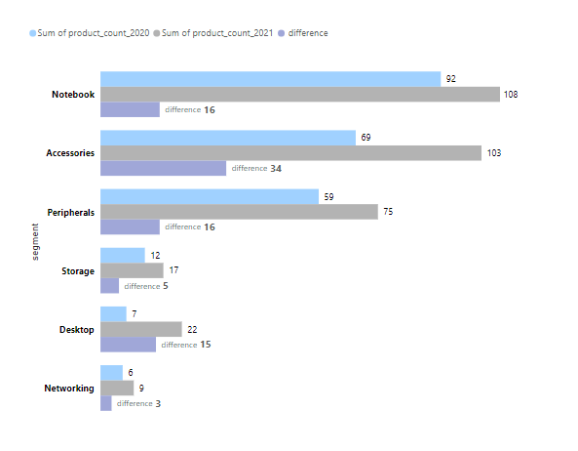
INSIGHTS:
Atliq Hardwares expanded its product portfolio across all segments from 2020 to 2021, with notable growth patterns The aggressive expansion in Accessories indicates a market strategy aimed at providing a complete ecosystem for customers. Meanwhile, the rising focus on Desktop products hints at diversification into enterprise solutions.

Slide 12

REQUEST 5:
Get the products that have the highest and lowest manufacturing costs.
The final output should contain these fields:
product_code
product
manufacturing_cost
QURIED RESULT

Slide 13


INSIGHTS:
High Manufacturing Cost Product: The AQ HOME Allin1 Gen 2 has a significantly higher manufacturing cost of 240.53 .This could indicate a premium product with advanced features or complex manufacturing processes. Low Manufacturing Cost Product: The AQ Master wired x1 Ms has a very low manufacturing cost of 0.8920 units. This could represent an entry-level or low-complexity product. There is a huge disparity between the manufacturing costs of the two products. The high-cost product could be a key revenue driver, while the low-cost product might be aimed at high-volume sales or as an accessory.
Atliq Home Allin Gen 2
AQ Master wired x 1Ms
240.53
0.8920

Slide 14
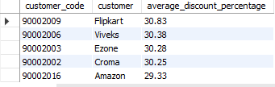
REQUEST 6:
Generate a report which contains the top 5 customers who received an
average high pre_invoice_discount_pct for the fiscal year 2021 and in the
Indian market. The final output contains these fields,
customer_code
customer
average_discount_percentage
QURIED RESULT

Slide 15

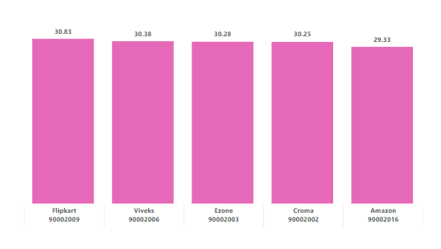
INSIGHTS:
The top customers of Atliq Hardwares receive similar average discount percentages, with slight variations:
Key Observations:
Flipkart receives the highest average discount at 30.83%, potentially due to higher sales volumes or strategic partnerships.
Other major retailers like Viveks (30.38%), Ezone (30.28%), and Croma (30.25%) receive comparable discount rates, indicating a standardized discounting approach across retail partners.
Amazon, while a key customer, has the lowest discount at 29.33%, which could reflect different negotiation outcomes or sales dynamics.

Slide 16
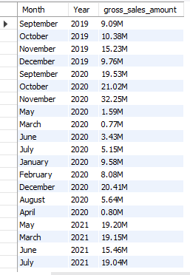
REQUEST 7:
Get the complete report of the Gross sales amount for the customer “Atliq
Exclusive” for each month. This analysis helps to get an idea of low and
high-performing months and take strategic decisions.
The final report contains these columns:
Month
Year
Gross sales Amount
QURIED RESULT

Slide 17
INSIGHTS:
Seasonal Trends:
There is a noticeable increase in sales during the latter part of each year, particularly in November and December. For example, November 2019 had sales of 15.23M, and November 2020 saw a significant jump to 32.25M.
September and October also show higher sales compared to other months, indicating a possible seasonal peak.
Impact of External Factors:
The data for 2020 shows a significant increase in sales compared to 2019, which could be influenced by external factors such as the COVID-19 pandemic, potentially driving higher online sales or changes in consumer behavior.

Slide 18
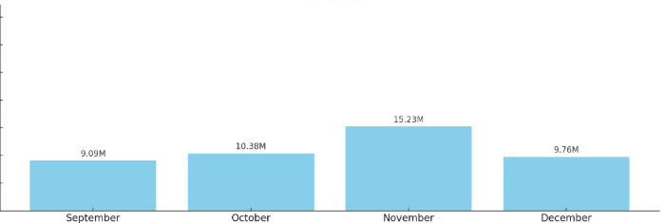
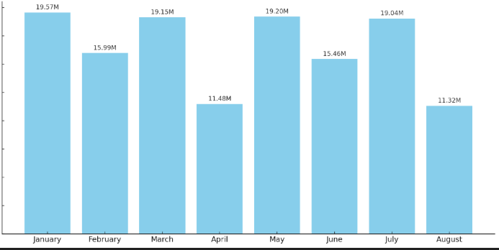
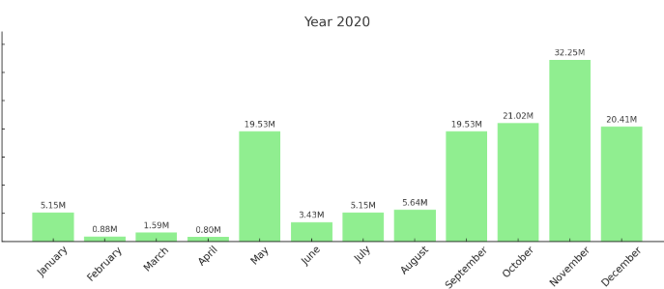
Year 2019
Year 2021

Slide 19

REQUEST 8:
In which quarter of 2020, got the maximum total_sold_quantity? The final
output contains these fields sorted by the total_sold_quantity,
Quarter
total_sold_quantity
QURIED RESULT

Slide 20
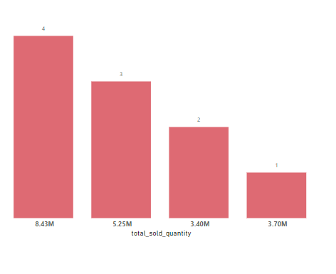
INSIGHTS:
Quarterly Trends:
The highest total hold quantity is in Quarter 4, with 8.43M.
Quarter 2 has the lowest total hold quantity at 3.40M.
Seasonal Patterns:
There is a noticeable increase in hold quantity from Quarter 3 to Quarter 4, which could indicate a seasonal peak in demand or inventory buildup towards the end of the year.
Quarter-over-Quarter Comparison:
Quarter 4 (8.43M) has more than double the hold quantity of Quarter 2 (3.40M).
Quarter 2 (3.40M) shows a moderate decrease compared to Quarter 1 (3.70M).

Slide 21

REQUEST 9:
Which channel helped to bring more gross sales in the fiscal year 2021
and the percentage of contribution? The final output contains these fields,
channel
gross_sales_mln
percentage
QURIED RESULT

Slide 22
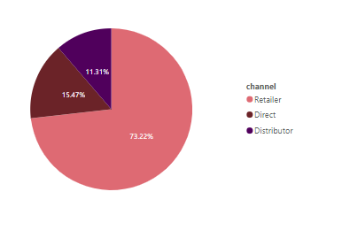
INSIGHTS:
Channel Dominance:
The Retailer channel accounts for the majority of gross sales at 78.22%, indicating it is the primary sales channel.
The Direct channel contributes 15.47% of gross sales, making it the second most significant channel.
The Retailer channel has the smallest share at 11.31%. The data suggests that the company has a strong retailer network, which could be a competitive advantage.
The smaller share of the distributor channel might indicate a strategic focus on other channels or potential untapped potential in distributor partnerships.

Slide 23
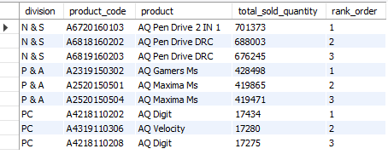
REQUEST 10:
Get the Top 3 products in each division that have a high
total_sold_quantity in the fiscal_year 2021? The final output contains these
fields,
division
product_code product
total_sold_quantity
rank_order
QURIED RESULT

Slide 24
INSIGHTS:
Top Performing Products:
In the "N & S" division, the top product is "AQ Pen Drive 2 IN 1" with 701,373 units sold, followed closely by "AQ Pen Drive DRC" variants.
In the "P & A" division, "AQ Gamers Ms" leads with 428,498 units sold, followed by "AQ Maxima Ms" variants.
In the "PC" division, "AQ Digit" is the top product with 17,434 units sold, closely followed by "AQ Velocity".
Product Popularity:
Products in the "N & S" and "P & A" divisions are significantly more popular than those in the "PC" division, as indicated by the higher total sold quantities.
The close sales figures among top products within each division suggest strong competition and possibly similar demand levels for these products.

Slide 25
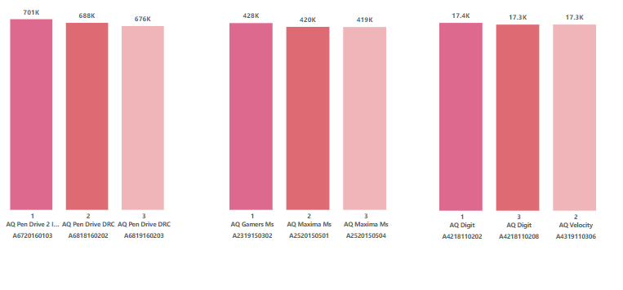
INSIGHTS:

